Slide 1

Business Insights
Arbaj Momin

Slide 2

To gain a comprehensive overview of our business, we will focus on key parameters including revenue, top 10 valuable customers, shipping analysis, sales distribution by category, distribution of customers by country and city, most popular payment method, and supplier analysis. These parameters provide crucial insights into our financial performance, customer behavior, logistics efficiency, market reach, and supply chain reliability, enabling us to make informed decisions and optimize our business strategy for sustainable growth

Slide 3
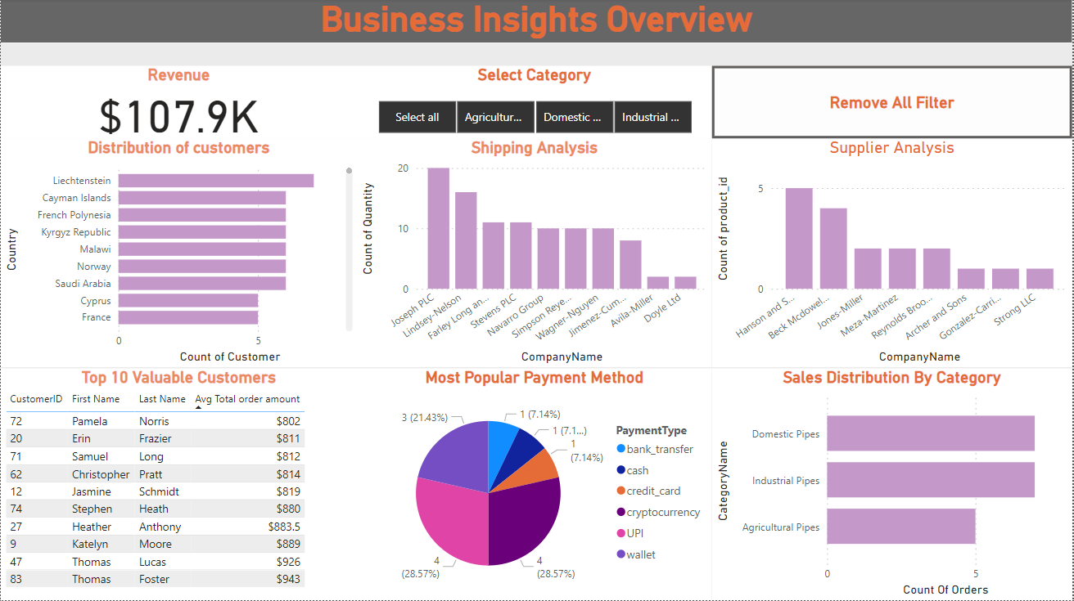

Slide 4

Business Overview
Revenue: Our total revenue is $107.9k, calculated based on the total number of orders received. This figure provides a clear indication of our financial performance
Customer Distribution: Our analysis reveals that most of our orders were placed from Liechtenstein, followed by the Cayman Islands and French Polynesia
Shipping Analysis: Our analysis indicates that Joseph PLC, Lindsey Nelson, and Farley Long Fisher were the top three shipping providers for our orders

Slide 5
Sales Distribution by Category: The highest number of orders were for domestic pipes and agricultural pipes, with both categories having the same number of orders. To further grow the agricultural pipe category, we need to strategize on increasing its demand and market share through targeted marketing and product development initiatives.
Most Popular Payment Method: Cryptocurrency and UPI emerge as the most popular payment methods among our customers, out of the six payment options available.
Supplier Analysis: Hanson and Sons emerged as the primary supplier, providing the highest number of products among all our suppliers.

Slide 6
Highlights and Areas for Improvement
Overall, our business has performed well in terms of revenue generation, with a total revenue of $107.9k. We have successfully identified our top customers, shipping providers, and popular payment methods, which has contributed to our operational efficiency and customer satisfaction. Additionally, our sales distribution by category highlights the popularity of domestic pipes and agricultural pipes. However, while domestic pipes have performed exceptionally well, there is room for improvement in growing the agricultural pipe category. Furthermore, while we have identified cryptocurrency and UPI as the most popular payment methods, we need to continue exploring strategies to enhance the popularity of other payment options. Finally, our supplier analysis shows that Hanson and Sons are our primary supplier, indicating a strong partnership; however, we should explore diversifying our supplier base to mitigate risks and ensure continuity in our supply chain. Overall, while we have several strengths, focusing on the areas of improvement will help us further optimize our business operations and drive future growth.

Slide 7

Thank you…!

